Slide 1
NCW Champion Schools - Enter Region
National Careers Week (NCW) is a celebration of careers guidance and free resources in education across the UK. The aim is to provide a focus for careers guidance activity at an important stage in the academic calendar to help support young people leaving education.

Slide 2
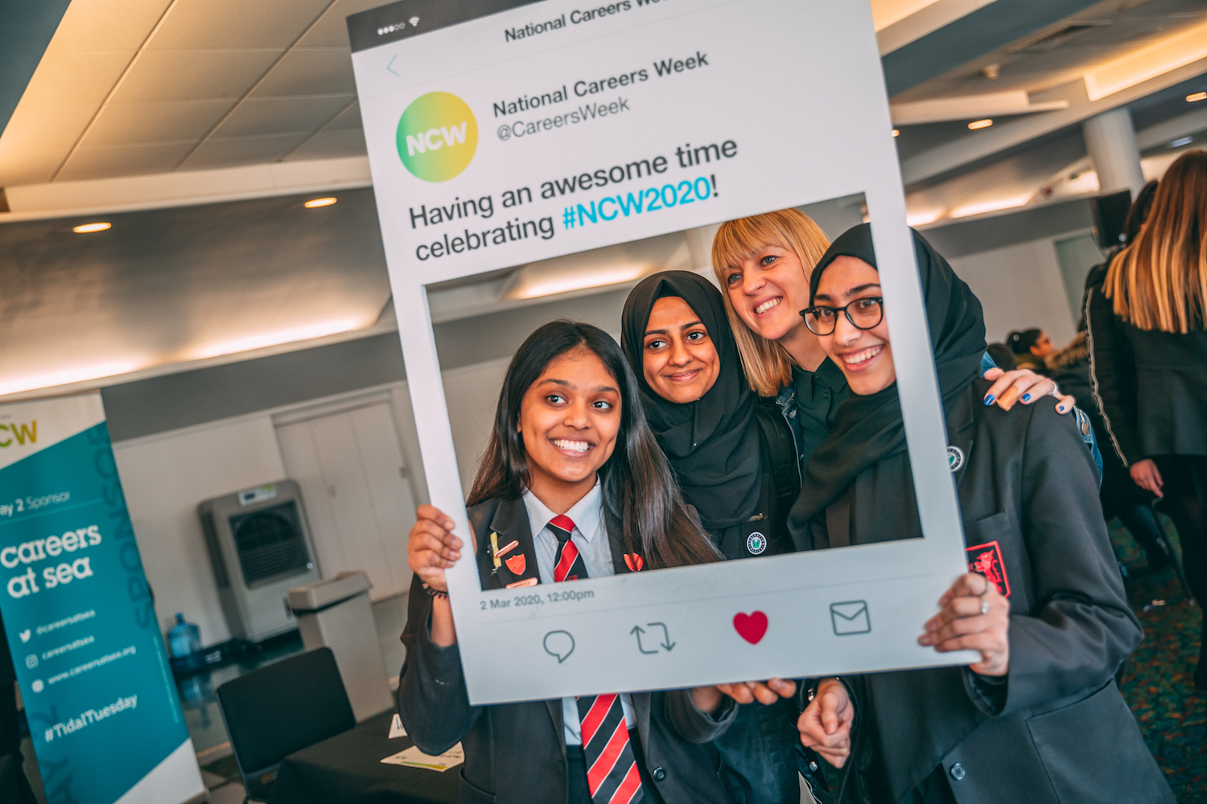
Why Get Involved?
Raise profile of the school during National Careers Week
Demonstrate pathways from education to employment within the region
Gain recognition for the contribution of staff and students to careers education.
Empower students and staff to take ownership of their careers program.
Work towards achieving 6 of the 8 Gatsby Benchmarks

Slide 3
NCW Champion Schools working towards meeting Gatsby Benchmarks

Slide 4
Benchmark 1
All schools should have a stable careers program.
In order to become a NCW champion school, schools must publish their careers program on their school website and include the activities undertaken to achieve NCW Champion school status.
NCW champion schools can ensure that their published program is being evaluated and can develop in line with feedback that they are collecting.

Slide 5
Benchmark 2
There should be learning from career and labour market information.
NCW Champion schools have access to local labour market information (LMI) from their regional LEP.
LEP info is disseminated to staff and students to inform teaching and learning.
LMI information can be used by students to inform decisions made around GCSE and post 16 options.

Slide 6
Benchmark 3
The careers program in school should address the needs of each student.
By careful selection of student champions across ability range and demographics, a NCW champion school can use their feedback to ensure that it’s careers program is inclusive and accessible.

Slide 7
Benchmark 4
Curriculum learning should be linked to careers.
Student NCW champions can work with subject leads within departments to help embed career learning into the curriculum.
Student NCW champions can research subject specific careers resources for departmental use.
Student NCW champions can find appropriate employers or professionals for subject leads to invite to speak to students.

Slide 8
Benchmark 5
Students need to have meaningful encounters with employers and employees.
Employer encounters can be student lead, meaning:
Student NCW champions can work with the careers leader or subject leads to find appropriate employers or professionals to invite to speak to students.
Students NCW champions can be guided in work with employers to ensure that encounters are positive and meaningful.

Slide 9
Benchmark 6
Students should have experience of workplaces.
NCW students champions are being asked to perform meaningful jobs, working with key stakeholders in the school careers program. Through their time as NCW student champions they will all be expected to have gained valuable work experience and developed their skills.
NCW student champions could be involved in workplace visits.

Slide 10
Champion School Expectations - Bronze
National Careers Week
Develop activity towards meeting Gatsby Benchmarks, share within school community
Select NCW resources to be used
Embed NCW throughout school - Staff/Business leader pledges and door signs
Student NCW Champions in every Year Group
Amplify - Social media tagging NCW, Regional LEP, Enterprise Adviser/Enterprise Coordinator
Publish School Careers Program on school website, including activity of NCW Careers Champions

Slide 11
Champion School Expectations - Silver
National Careers Week
Develop activity towards meetings Gatsby Benchmarks, share within LEP region and within school community
Select NCW resources to be used
Embed NCW throughout school - Staff/EA/Business leader pledges and door signs
Student NCW Champions in every Year Group
Staff Careers Champion in each department
Amplify - Social media tagging NCW, Regional LEP, Enterprise Adviser/Enterprise Coordinator
Publish School Careers Program on school website, including activity of NCW Careers Champions

Slide 12
Champion School Expectations - Gold
National Careers Week
Develop calendar of activity for the week, share within LEP region and within school community
Select NCW resources to be used
Embed NCW throughout school - Staff/EA/Business leader pledges and door signs
Student NCW Champions in every Year Group
Staff Careers Champion in each department
Amplify - Social media tagging NCW, Regional LEP, Enterprise Adviser/Enterprise Coordinator
Publish School Careers Program on school website, including activity of NCW Careers Champions
Submit NCW Case Study

Slide 13
Suggested Activities for NCW Champion Schools
Align school careers program with LEP regional growth sectors/ local LMI
Launch programme using NCW resources - slides for form tutors, door signs, posters
Source guest speakers for assembly or lessons (can be virtual)
Involve Enterprise Adviser/ Link Governor in meetings with NCW student champions (can be virtual).
Ask departmental career leads to link a department lesson or part of a lesson to a selected growth sector, and/or link their subject to skills and careers.
Survey a group at beginning of a programme cycle and the end via student NCW champions. Use feedback to inform planning for next year.
Involve NCW student champions in recruitment/ induction of new NCW student champions.
In second year ask NCW student champions to act as mentors to new NCW student champions.

Slide 14
Insert Regional LEP Slides
Slide content

Slide 15
Insert Regional LEP Slides
Slide content

Slide 16
Insert Regional LEP Slides
Slide content

Slide 17
Insert Regional LEP Slides
Slide content

Slide 18
Amplify the message!
Who to tag
@CareersWeek
@[school]
@[school careers]
@[LEP]
@[EA/EC]
@[NCWambassador]
Hashtags
#NCW2021

